Slide 1
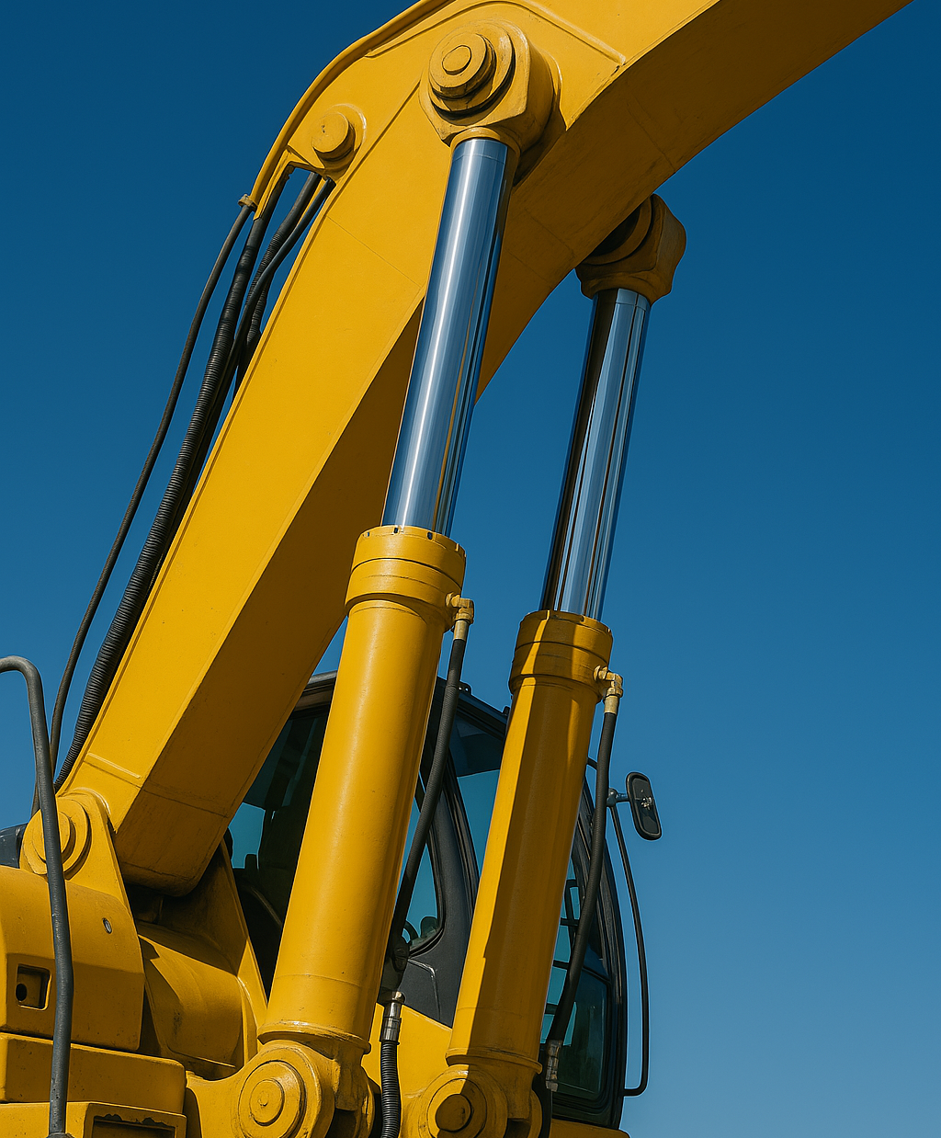
Online
Taster Course
Mechanical Engineering
Institute of Engineering
Hydraulics & Pneumatics
Course: Fluid Mechanics
Lecturer: Ing. D. Tettero
d.tettero@pl.hanze.nl

Slide 2
Definitions
Hydraulic
Greek word “hydro” → means water/liquid
Pneumatic
Greek word “pneumatikos” → from the wind → gas
We use fluid to perform work in a system

Slide 3
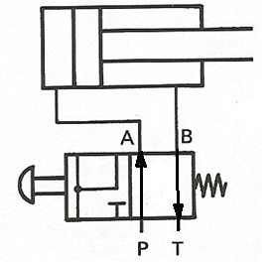

Basic Principle
Hydraulic Cylinder
Piston
Piston Rod
Not to scale / approximated
Hydraulic fluid
  High pressure (energized)
  No pressure (atmospheric)
Symbols
  P = Pressure port
  T = Tank port
  A/B = Working ports
Valve
A
B
Spring
Button
P
T
Tank
Pump

Slide 4

Basic Principle
Hydraulic Cylinder
Piston
Piston Rod
Double acting cylinder
  Extends (goes out)
  Retracts (goes in)
Difference in surface area
  $A_{k}=Area_{piston} \left[mm^{2}\right]$
  $A_{r}=Area_{annulus} \left[mm^{2}\right]$
  Diameters $D$ $\& d [mm]$
Pump flow $Q \left[L/min\right]$
Pressure $p \left[MPa\right]$
Stroke $s \left[mm\right]$
Force $F \left[N\right]$
Valve
A
B
Spring
Button
P
T
Tank
Pump

Slide 5
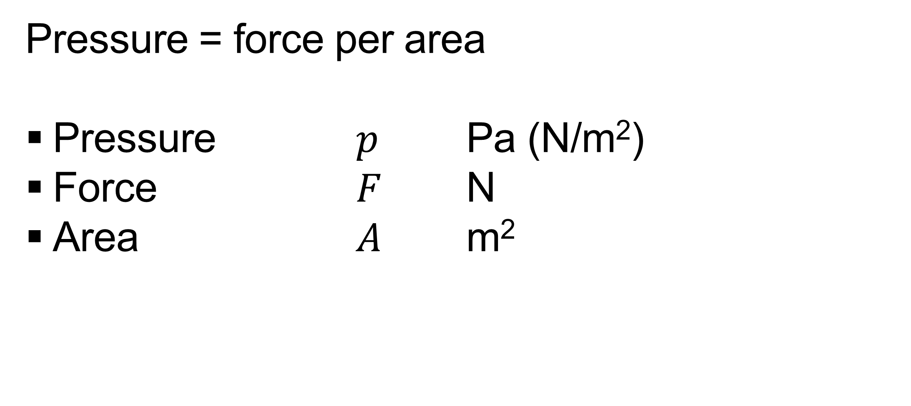

Pascal’s Law
Pressure = force per area
Pressure $p$ Pa (N/m²)
Force $F$ N
Area $A$ m²
$$p=\frac{F}{A}$$

Slide 6
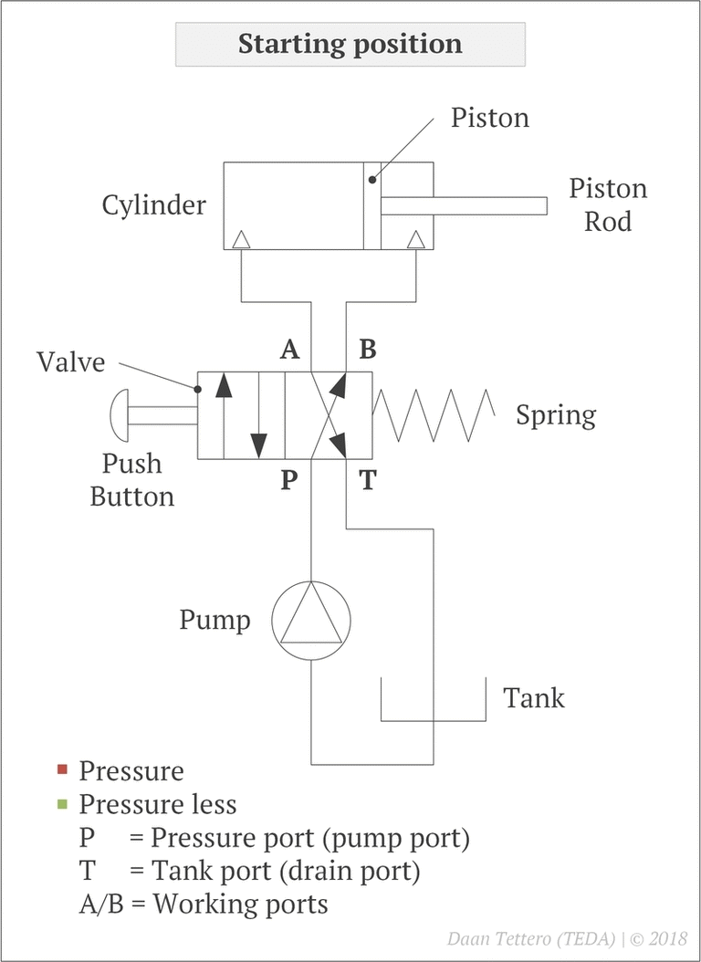

Exercise
Given:
  Piston area $1000 mm^{2}$
  Annulus area $600 mm^{2}$
  Pump Flow $6 L/min$
  Stroke $0.6 m$
  Force (*ex/re) $10 kN$
Calculate: for both strokes (*extension & retraction)
  Required pressure $\left[MPa\right]$
  Linear speed piston $\left[m/s\right]$
  Work $\left[J\right]$
  Power $\left[W\right]$

Slide 7
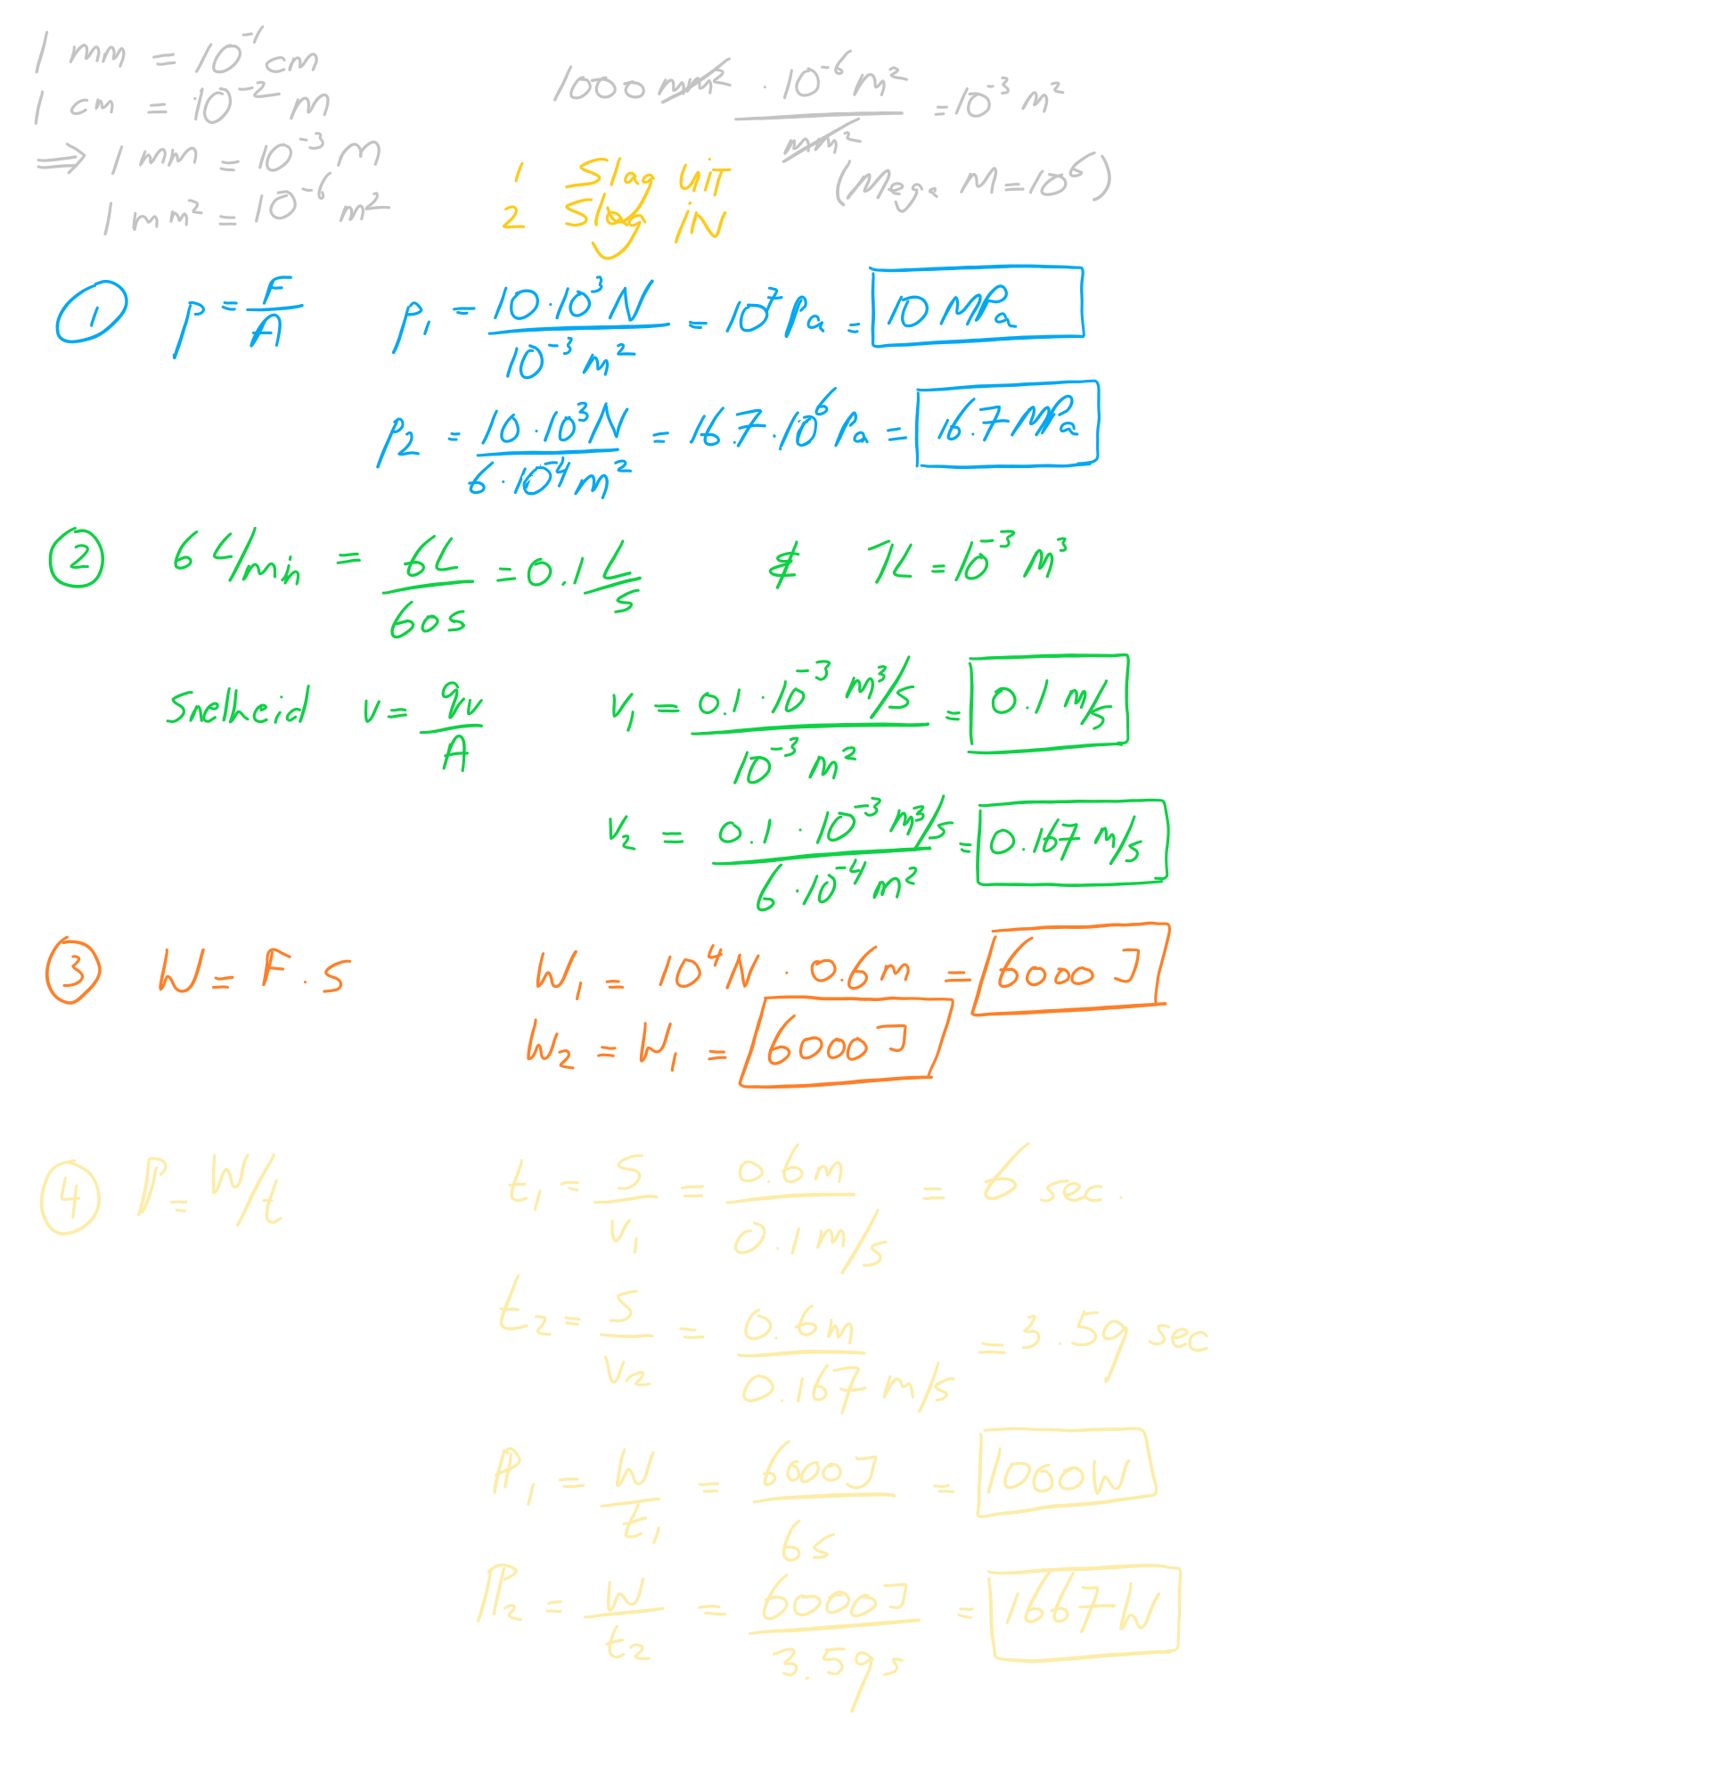

Exercise Solution
Calculate: for both strokes
(extension & retraction)
  Required pressure $\left[MPa\right]$
  Linear speed piston $\left[m/s\right]$
  Work $\left[J\right]$
  Power $\left[W\right]$

Slide 8

More?
Check out the full recorded lectures from 2022:
YouTube Playlist

